Slide 1

Chapter 8. Classification: Evaluation
Meng Jiang
CSE 40647/60647 Data Science Fall 2017

Slide 2
Review: Decision Tree Classifier
Training:
 |  |  | Is Home/Away? | Is Opponent in AP Top 25 at Preseason? | Media | Label: Win/Lose
1 | 9/2/17 | Temple | Home | Out | 1-NBC | Win
2 | 9/9/17 | Georgia | Home | In | 1-NBC | Lose
3 | 9/16/17 | Boston College | Away | Out | 2-ESPN | Win
4 | 9/23/17 | Michigan State | Away | Out | 3-FOX | Win
5 | 9/30/17 | Miami Ohio | Home | Out | 1-NBC | Win
6 | 10/7/17 | North Carolina | Away | Out | 4-ABC | Win
Model:
Is Opponent …Top25?
In
Out
Lose
Win
Test:
1 | 10/21/17 | USC | Home | In | 1-NBC | Lose
2 | 10/28/17 | North Carolina State | Home | Out | 1-NBC | Win
3 | 11/4/17 | Wake Forest | Home | Out | 1-NBC | Win
4 | 11/18/17 | Navy | Home | Out | 1-NBC | Win

Slide 3
Review: Naïve Bayes Classifier
Training:
 |  |  | Is Home/Away? | Is Opponent in AP Top 25 at Preseason? | Media | Label: Win/Lose
1 | 9/2/17 | Temple | Home | Out | 1-NBC | Win
2 | 9/9/17 | Georgia | Home | In | 1-NBC | Lose
3 | 9/16/17 | Boston College | Away | Out | 2-ESPN | Win
4 | 9/23/17 | Michigan State | Away | Out | 3-FOX | Win
5 | 9/30/17 | Miami Ohio | Home | Out | 1-NBC | Win
6 | 10/7/17 | North Carolina | Away | Out | 4-ABC | Win
Model:
1 | 10/21/17 | USC | Home | In | 1-NBC | ?
Prior probability:
P(Win) = 5/6, P(Lose) = 1/6
Likelihood:
P(Home|Win) = 2/5
P(Home|Lose) = 1/1
P(In|Win) = 0/5
P(In|Lose) = 1/1
P(NBC|Win) = 2/5
P(NBC|Lose) = 1/1
Posteriori probability:
P(Win|X) = 2/5 * 0/5 * 2/5 * 5/6 / P(X)
= 0.0 / P(X)
P(Lose|X) = 1/1 * 1/1 * 1/1 *1/6 / P(X)
= 0.167 / P(X)
Conclusion: Lose

Slide 4
Zero-Probability: Laplacian Correction
Training:
 |  |  | Is Home/Away? | Is Opponent in AP Top 25 at Preseason? | Media | Label: Win/Lose
1 | 9/2/17 | Temple | Home | Out | 1-NBC | Win
2 | 9/9/17 | Georgia | Home | In | 1-NBC | Lose
3 | 9/16/17 | Boston College | Away | Out | 2-ESPN | Win
4 | 9/23/17 | Michigan State | Away | Out | 3-FOX | Win
5 | 9/30/17 | Miami Ohio | Home | Out | 1-NBC | Win
6 | 10/7/17 | North Carolina | Away | Out | 4-ABC | Win
Model:
1 | 10/21/17 | USC | Home | In | 1-NBC | ?
Prior probability:
P(Win) = 6/8, P(Lose) = 2/8
Likelihood:
P(Home|Win) = 3/6
P(Home|Lose) = 2/2
P(In|Win) = 1/6
P(In|Lose) = 2/2
P(NBC|Win) = 3/6
P(NBC|Lose) = 2/2
Posteriori probability:
P(Win|X) = 3/6 * 1/6 * 3/6 * 6/8 / P(X)
= 0.03 / P(X)
P(Lose|X) = 2/2 * 2/2 * 2/2 *2/8 / P(X)
= 0.25 / P(X)
Conclusion: Lose

Slide 5

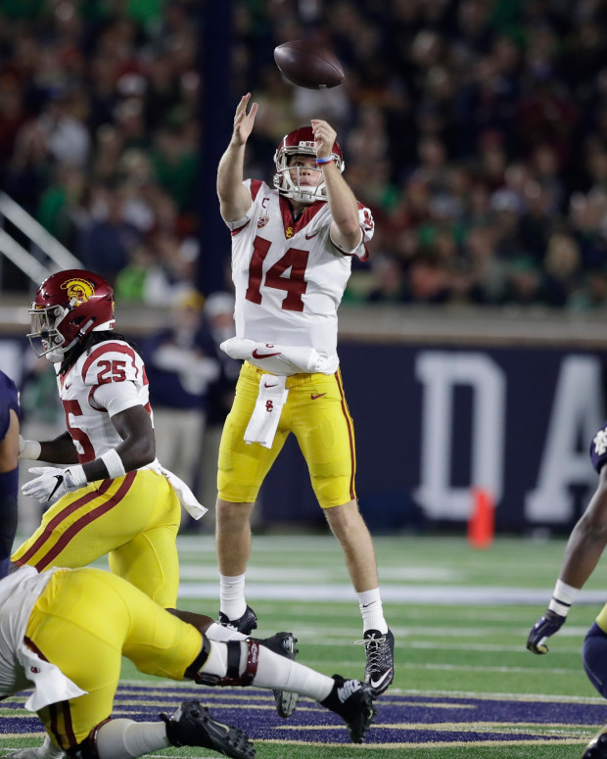
USC 14 – 49 Notre Dame
None of the classifiers is correct!
Training is not sufficient…
Instances
Features
Models

Slide 6
Paper Organization
Suppose we are writing a paper: We propose a “novel” model, the Naïve Bayes model, to address the problem of classification.
1. Introduction
Why do we study the problem of classification? Applications such as predicting “play tennis or not” given weather data.
Existing models: Decision Trees. Issue: Ignoring useful though not the “best” features.
Major challenges: Lack of theoretical foundation on considering distributions of all the attributes in massive training instances.
Idea: Borrow Bayes Theorem. Proposed method: P(H|X) = P(X|H)P(H)/P(X). Why it works (and work better than DTs)?
Itemize major contributions

Slide 7
Paper Organization (cont.)
2. Related Work
Survey two or three fields of work relevant to your paper on different aspects: (1) Classification models (e.g., Decision Trees), (2) Studies using Bayes Theorem
3. Problem Definition
Given … training(instances, features, labels) and testing(instances, features), find … testing(labels)
4. Proposed Model
and Algorithm (components and pseudo code)
5. Experiments (to demonstrate your itemized contributions)
6. Conclusions/Discussions (followed with Acks and Refs)

Slide 8
“Experiments” Organization
[Questions to answer in this section…]
Q1: Does the proposed method perform effectively on … ?
Q2: …?
5.1 Datasets
5.2 Experimental settings
Baselines (ID3, C4.5, CART, etc.)
Parameter settings (Normalization? Laplacian correction?)
Validation settings (training, testing …) !!!
Evaluation metrics (accuracy, precision, recall …) !!!
5.3 Binary Classification (Q1)
5.3.1 Quantitative analysis
5.3.2 Qualitative analysis (case studies)
5.4 … (Q2)

Slide 9
Today’s Lecture: Evaluation
Validation Settings
Hold-out validation method
Cross-validation methods (+ Stratified)
k-fold cross-validation
Leave-one-out validation
Evaluation Metrics
Confusion matrix
Accuracy, Error rate
Sensitivity, Specificity
Precision, Recall, F measure, G measure
ROC curves, Area Under the Curve (AUC), Precision-Recall Curve
Precision@K, Average precision
Mean absolute error (MAE), Root mean squared error (RMSE)
Ranking-based measures (Kendall’s tau, Spearman’s rho)

Slide 10
Today’s Lecture: Evaluation
Validation Settings
Hold-out validation method
Cross-validation methods (+ Stratified)
k-fold cross-validation
Leave-one-out validation
Evaluation Metrics
Confusion matrix
Accuracy, Error rate
Sensitivity, Specificity
Precision, Recall, F measure, G measure
ROC curves, Area Under the Curve (AUC), Precision-Recall Curve
Precision@K, Average precision
Mean absolute error (MAE), Root mean squared error (RMSE)
Ranking-based measures (Kendall’s tau, Spearman’s rho)

Slide 11
Holdout Validation
Given data is randomly partitioned into two independent sets
Training set (e.g., 2/3, 3/5, 4/5) for model construction
Test set (e.g., 1/3, 2/5, 1/5) for accuracy estimation
Repeat holdout k times, accuracy = avg. of the accuracies obtained
Standard deviation?

Slide 12
Holdout Validation: Example (k=2)
 | Features |  |  | Label
1
2
3
4
 | Features |  |  | Label
5
6
Test Set
 | Features |  |  | Label
1
2
3
4
5
6
Training Set
Data Set
 | Features |  |  | Label
1
2
4
5
 | Features |  |  | Label
3
6
Test Set
Training Set

Slide 13
Today’s Lecture: Evaluation
Validation Settings
Hold-out validation method
Cross-validation methods (+ Stratified)
k-fold cross-validation
Leave-one-out validation
Evaluation Metrics
Confusion matrix
Accuracy, Error rate
Sensitivity, Specificity
Precision, Recall, F measure, G measure
ROC curves, Area Under the Curve (AUC), Precision-Recall Curve
Precision@K, Average precision
Mean absolute error (MAE), Root mean squared error (RMSE)
Ranking-based measures (Kendall’s tau, Spearman’s rho)

Slide 14
k-fold Cross Validation
Given data D is randomly partitioned into k mutually exclusive subsets D_{i} (i = 1, …, k), each approximately equal size |D_{i}|
At i-th iteration (i = 1, …, k), use D_{i} as test set for accuracy estimation and others D₁∪…∪D_{i-1}∪D_{i+1}∪…∪D_{k} as training set for model construction
k=10 is the most popular

Slide 15
k-fold Cross Validation: Example (k=3)
 | Features |  |  | Label
1
2
3
4
5
6
 | Features |  |  | Label
3
4
5
6
 | Features |  |  | Label
1
2
Data Set
Test Set
Training Set
 | Features |  |  | Label
1
2
5
6
 | Features |  |  | Label
3
4
 | Features |  |  | Label
1
2
Test Set
Training Set
 | Features |  |  | Label
3
4
 | Features |  |  | Label
1
2
3
4
 | Features |  |  | Label
5
6
Test Set
 | Features |  |  | Label
5
6
Training Set

Slide 16
Today’s Lecture: Evaluation
Validation Settings
Hold-out validation method
Cross-validation methods (+ Stratified)
k-fold cross-validation
Leave-one-out validation
Evaluation Metrics
Confusion matrix
Accuracy, Error rate
Sensitivity, Specificity
Precision, Recall, F measure, G measure
ROC curves, Area Under the Curve (AUC), Precision-Recall Curve
Precision@K, Average precision
Mean absolute error (MAE), Root mean squared error (RMSE)
Ranking-based measures (Kendall’s tau, Spearman’s rho)

Slide 17
Leave-one (k)-out Validation
Given small-sized data is randomly partitioned into a training set and a test set. The size of the test set is k, i.e., number of test tuples.
 | Features |  |  | Label
1
2
3
4
5
 | Features |  |  | Label
6
 | Features |  |  | Label
1
2
3
4
5
6
Test Set
Training Set
Data Set
 | Features |  |  | Label
1
2
4
5
6
 | Features |  |  | Label
3
k = 1
Test Set
Training Set

Slide 18
Today’s Lecture: Evaluation
Validation Settings
Hold-out validation method
Cross-validation methods (+ Stratified)
k-fold cross-validation
Leave-one-out validation
Evaluation Metrics
Confusion matrix
Accuracy, Error rate
Sensitivity, Specificity
Precision, Recall, F measure, G measure
ROC curves, Area Under the Curve (AUC), Precision-Recall Curve
Precision@K, Average precision
Mean absolute error (MAE), Root mean squared error (RMSE)
Ranking-based measures (Kendall’s tau, Spearman’s rho)

Slide 19
Stratified Cross-Validation
Folds are stratified so that class distribution in each fold is approximately the same as that in initial data.
 | Features |  |  | Label
*50 |  |  |  | Win
*30 |  |  |  | Loss
*5 |  |  |  | Draw
 | Features |  |  | Label (Win/Loss/Draw)
1 … 500 |  |  |  | Win
501 … 800 |  |  |  | Loss
801 … 850 |  |  |  | Draw
10-fold stratified cross-validation
 | Features |  |  | Label
*50 |  |  |  | Win
*30 |  |  |  | Loss
*5 |  |  |  | Draw
…
 | Features |  |  | Label
*50 |  |  |  | Win
*30 |  |  |  | Loss
*5 |  |  |  | Draw

Slide 20
Check List: Validation Settings
Holdout validation
k-fold cross-validation
Leave-one-out validation
Stratified cross-validation

Slide 21
Today’s Lecture: Evaluation
Validation Settings
Hold-out validation method
Cross-validation methods (+ Stratified)
k-fold cross-validation
Leave-one-out validation
Evaluation Metrics
Confusion matrix
Accuracy, Error rate
Sensitivity, Specificity
Precision, Recall, F measure, G measure
ROC curves, Area Under the Curve (AUC), Precision-Recall Curve
Precision@K, Average precision
Mean absolute error (MAE), Root mean squared error (RMSE)
Ranking-based measures (Kendall’s tau, Spearman’s rho)

Slide 22
Metrics: (1) Confusion Matrix
Given m classes, an entry, CM_{i,j} in a confusion matrix CM indicates the number of tuples in class i (actual class) that were labeled by the classifier as class j (predicted class)
May have extra rows/columns to provide totals
Actual class\Predicted class | C | ¬ C
C | True Positives (TP) | False Negatives (FN)
¬ C | False Positives (FP) | True Negatives (TN)
Actual class\Predicted class | game_result = “win” | game_result = “loss” | Total
game_result = “win” | 6,954 | 46 | 7,000
game_result = “loss” | 412 | 2,588 | 3,000
Total | 7,366 | 2,634 | 10,000

Slide 23
Today’s Lecture: Evaluation
Validation Settings
Hold-out validation method
Cross-validation methods (+ Stratified)
k-fold cross-validation
Leave-one-out validation
Evaluation Metrics
Confusion matrix
Accuracy, Error rate
Sensitivity, Specificity
Precision, Recall, F measure, G measure
ROC curves, Area Under the Curve (AUC), Precision-Recall Curve
Precision@K, Average precision
Mean absolute error (MAE), Root mean squared error (RMSE)
Ranking-based measures (Kendall’s tau, Spearman’s rho)

Slide 24
Metrics: (2) Accuracy, Error Rate
Classifier Accuracy, or recognition rate: percentage of test set tuples that are correctly classified
Accuracy = (TP + TN)/All
Error rate: 1 – accuracy, or
Error rate = (FP + FN)/All
A\P | C | ¬C
C | TP | FN | P
¬C | FP | TN | N
 | P’ | N’ | All
A\P | C | ¬C
C | 1000 | 1800 | 2800
¬C | 1200 | 1000 | 2200
 | 2200 | 2800 | 5000
Accuracy = 2000/5000
= 0.4
Error rate = 3000/5000
= 0.6
Example: C = (game_result = “win”)

Slide 25
Today’s Lecture: Evaluation
Validation Settings
Hold-out validation method
Cross-validation methods (+ Stratified)
k-fold cross-validation
Leave-one-out validation
Evaluation Metrics
Confusion matrix
Accuracy, Error rate
Sensitivity, Specificity
Precision, Recall, F measure, G measure
ROC curves, Area Under the Curve (AUC), Precision-Recall Curve
Precision@K, Average precision
Mean absolute error (MAE), Root mean squared error (RMSE)
Ranking-based measures (Kendall’s tau, Spearman’s rho)

Slide 26
Metrics: (3) Sensitivity, Specificity
Class Imbalance Problem:
One class may be rare, e.g. fraud, or HIV-positive
N >> P
Significant majority of the negative class and minority of the positive class
Then TN could be high and Accuracy = (TP + TN)/All could be high
A\P | C | ¬C
C | TP | FN | P
¬C | FP | TN | N
 | P’ | N’ | All
A\P | C | ¬C
C | 1000 | 1800 | 2800
¬C | 1200 | 96000 | 97200
 | 2200 | 97800 | 100000
Accuracy = 97000/100000
= 0.97
Error rate = 3000/100000
= 0.03
Example: C = (cancer= “yes”)

Slide 27
Metrics: (3) Sensitivity, Specificity
Sensitivity: True Positive recognition rate
Sensitivity = TP/P
Specificity: True Negative recognition rate
Specificity = TN/N
A\P | C | ¬C
C | TP | FN | P
¬C | FP | TN | N
 | P’ | N’ | All
A\P | C | ¬C
C | 1000 | 1800 | 2800
¬C | 1200 | 96000 | 97200
 | 2200 | 97800 | 100000
Sensitivity = 1000/2800
= 0.357
Specificity = 96000/97800
=0.982
Example: C = (cancer= “yes”)

Slide 28
Today’s Lecture: Evaluation
Validation Settings
Hold-out validation method
Cross-validation methods (+ Stratified)
k-fold cross-validation
Leave-one-out validation
Evaluation Metrics
Confusion matrix
Accuracy, Error rate
Sensitivity, Specificity
Precision, Recall, F measure, G measure
ROC curves, Area Under the Curve (AUC), Precision-Recall Curve
Precision@K, Average precision
Mean absolute error (MAE), Root mean squared error (RMSE)
Ranking-based measures (Kendall’s tau, Spearman’s rho)

Slide 29
Metrics: (4) Precision, Recall
Precision, or exactness: what % of tuples that the classifier labeled as positive are actually positive?
Precision = TP/(TP+FP) = TP/P’
Recall, or completeness: what % of positive tuples did the classifier label as positive?
Recall = TP/(TP+FN) = TP/P, the same as sensitivity
A\P | C | ¬C
C | TP | FN | P
¬C | FP | TN | N
 | P’ | N’ | All
A\P | C | ¬C
C | 1000 | 1800 | 2800
¬C | 1200 | 96000 | 97200
 | 2200 | 97800 | 100000
Precision = 1000/2200
= 0.455
Recall = 1000/2800
= 0.357
Example: C = (cancer= “yes”)

Slide 30
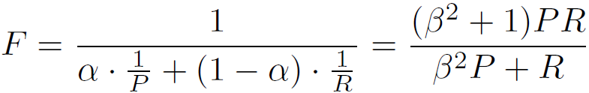
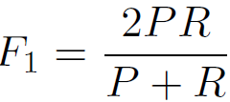
Metrics: (4’) F Measure
F measure, or F-score: harmonic mean of precision and recall
In general, it is the weighted measure of precision and recall, also called Fβ-score:
F1-measure (balanced F-measure)
That is, when β = 1,
Other two F meausres
F₂
F_{0.5}
Assigning β² times as much weight to recall as to precision
α=1/(1+β²)
Precision = 1000/2200
= 0.455
Recall = 1000/2800
= 0.357
F1 = 0.400
F2 = 0.373
F_{0.5} = 0.431
A\P | C | ¬C
C | 1000 | 1800 | 2800
¬C | 1200 | 96000 | 97200
 | 2200 | 97800 | 100000

Slide 31
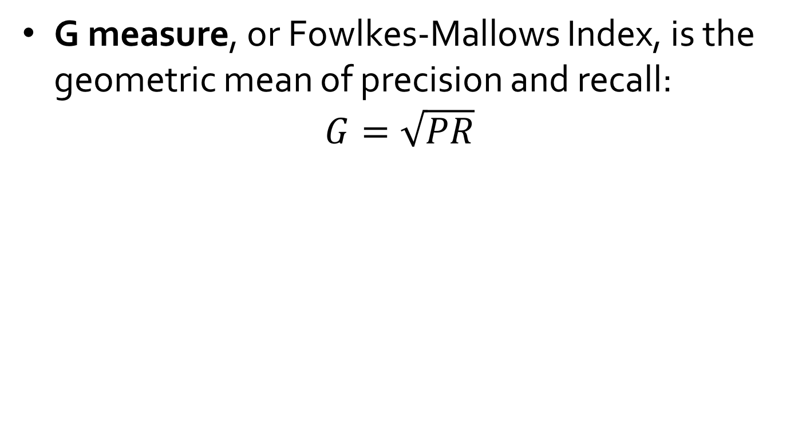
Metrics: (4’’) G Measure
G measure, or Fowlkes-Mallows Index, is the geometric mean of precision and recall:
$$G=\sqrt{PR}$$
A\P | C | ¬C
C | 1000 | 1800 | 2800
¬C | 1200 | 96000 | 97200
 | 2200 | 97800 | 100000
Precision = 1000/2200
= 0.455
Recall = 1000/2800
= 0.357
G = 0.403

Slide 32
Today’s Lecture: Evaluation
Validation Settings
Hold-out validation method
Cross-validation methods (+ Stratified)
k-fold cross-validation
Leave-one-out validation
Evaluation Metrics
Confusion matrix
Accuracy, Error rate
Sensitivity, Specificity
Precision, Recall, F measure, G measure
ROC curves, Area Under the Curve (AUC), Precision-Recall Curve
Precision@K, Average precision
Mean absolute error (MAE), Root mean squared error (RMSE)
Ranking-based measures (Kendall’s tau, Spearman’s rho)

Slide 33
Metrics: (5) ROC Curve
What is it?
ROC (Receiver Operating Characteristics) curves: for visual comparison of classification models.
Originated from signal detection theory: Developed in 1950s to analyze noisy signals.
Shows the trade-off between the true positive rate and the false positive rate.
TPR = TP/P = TP/(TP+FN)
FPR = FP/N = FP/(FP+TN)
A\P | C | ¬C
C | TP | FN | P
¬C | FP | TN | N
 | P’ | N’ | All

Slide 34
Metrics: (5) ROC Curve
How to plot?
Rank the test tuples in decreasing order: the one that is most likely to belong to the positive class appears at the top of the list
Vertical axis represents the true positive rate
Horizontal axis represents the false positive rate
1
ideal
real
TPR = TP/P = TP/(TP+FN)
FPR = FP/N = FP/(FP+TN)
True positive rate
0
0
1
False positive rate

Slide 35
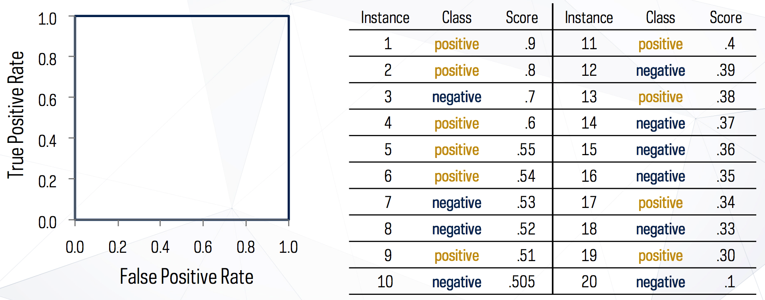
Generating ROC Curves

Slide 36
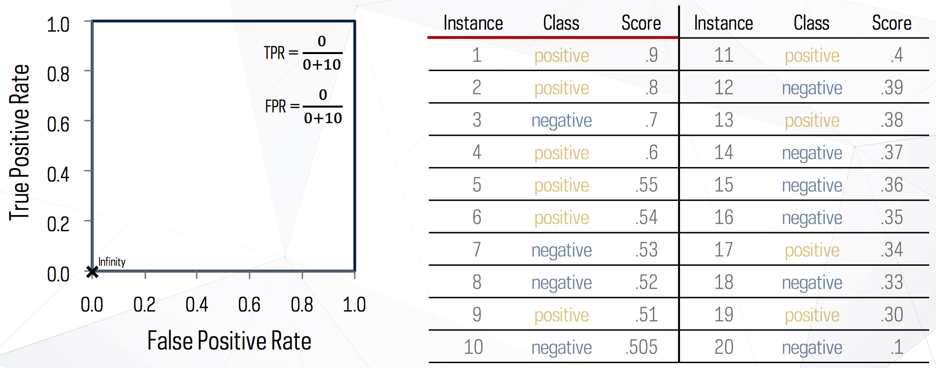
Generating ROC Curves (cont.)
TPR = TP/P = TP/(TP+FN)
FPR = FP/N = FP/(FP+TN)

Slide 37
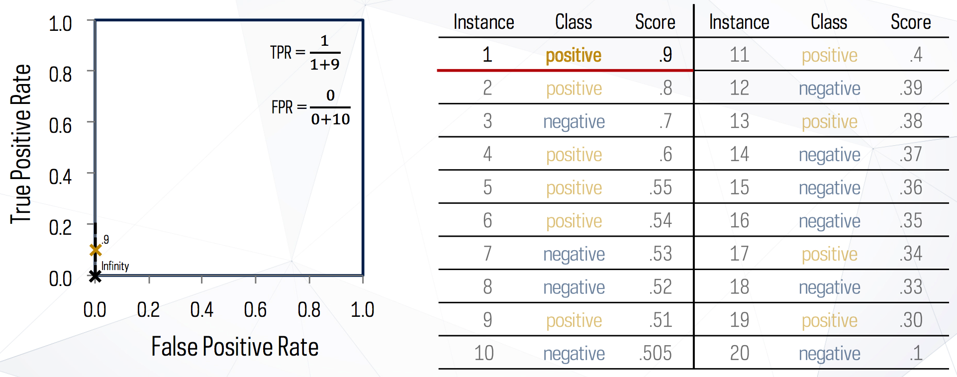
Generating ROC Curves (cont.)
TPR = TP/P = TP/(TP+FN)
FPR = FP/N = FP/(FP+TN)

Slide 38
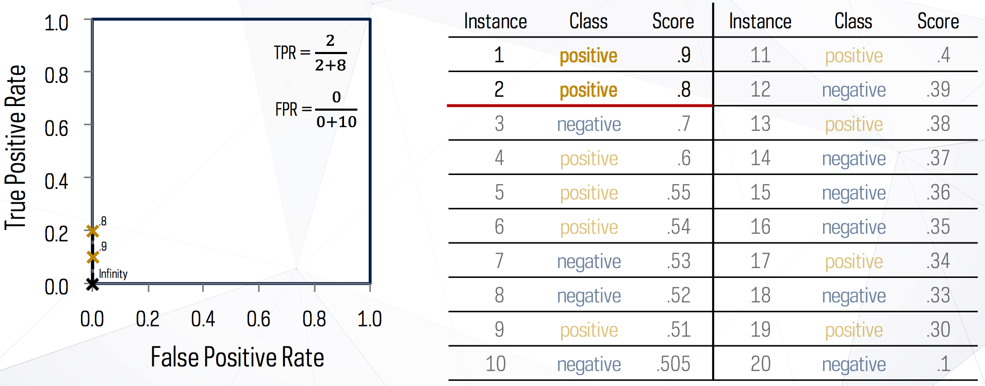
Generating ROC Curves (cont.)
TPR = TP/P = TP/(TP+FN)
FPR = FP/N = FP/(FP+TN)

Slide 39
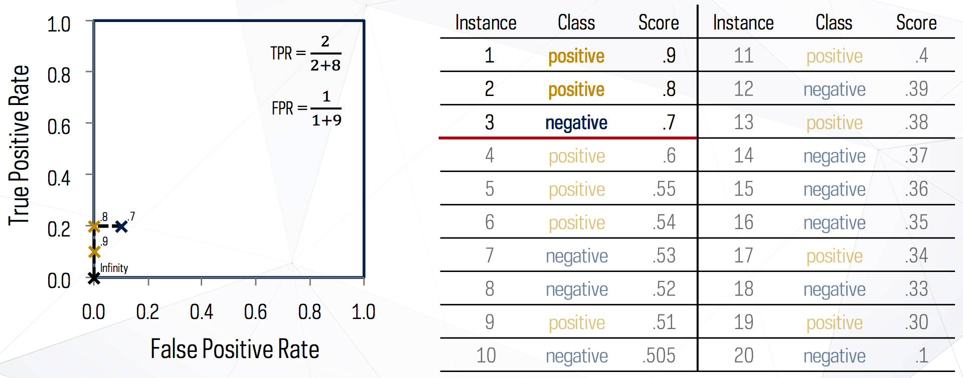
Generating ROC Curves (cont.)
TPR = TP/P = TP/(TP+FN)
FPR = FP/N = FP/(FP+TN)

Slide 40
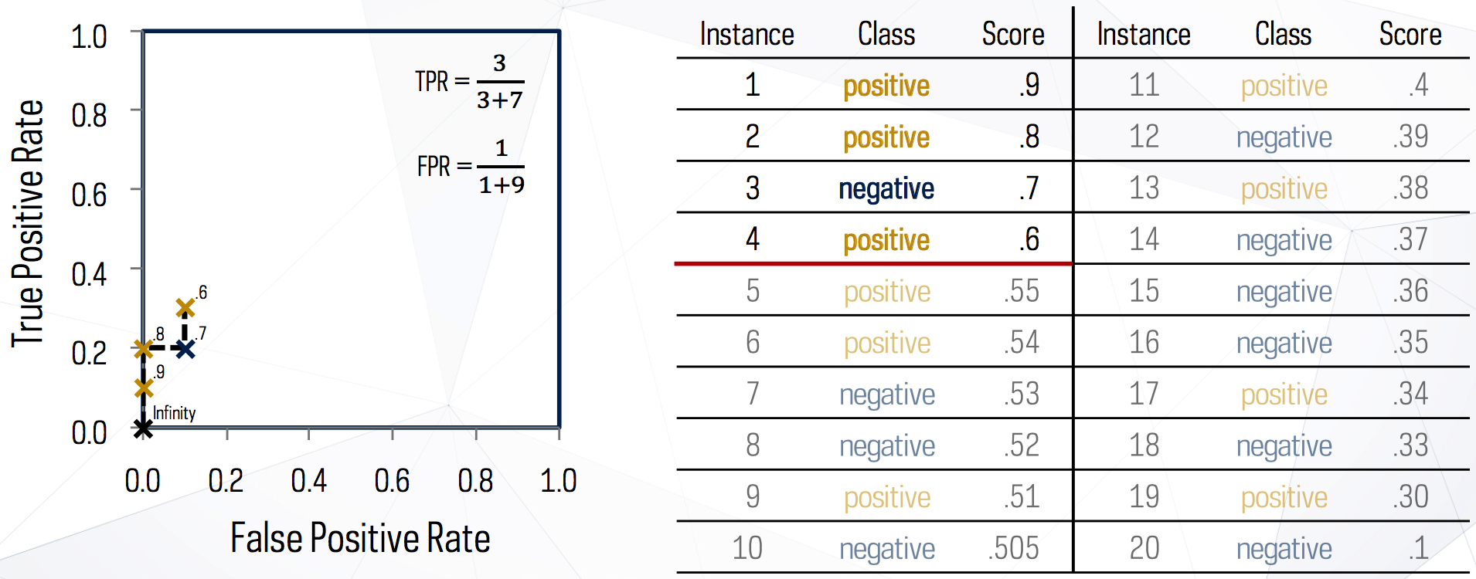
Generating ROC Curves (cont.)
TPR = TP/P = TP/(TP+FN)
FPR = FP/N = FP/(FP+TN)

Slide 41
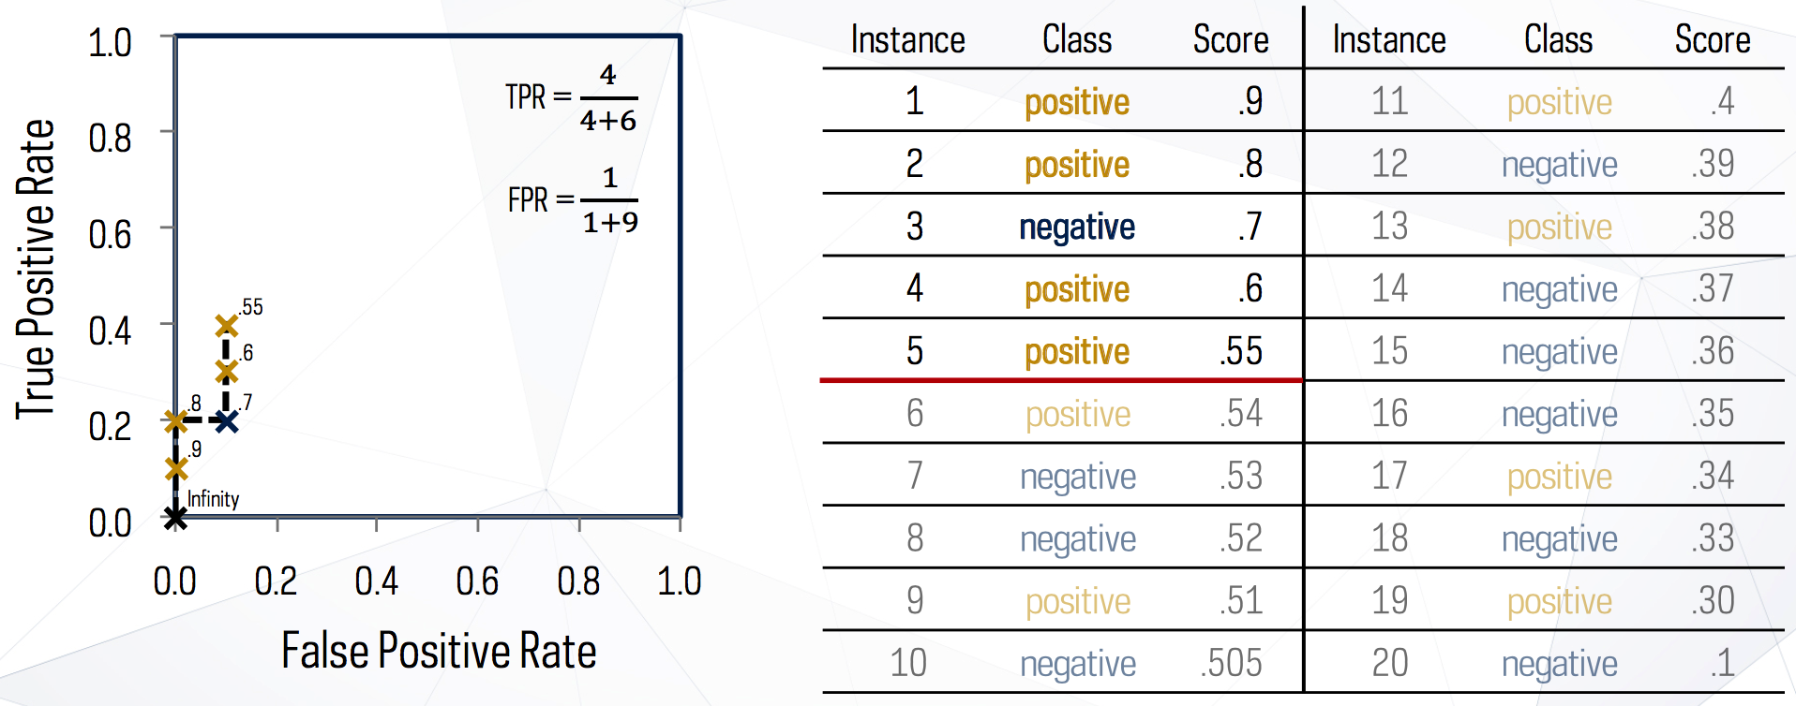
Generating ROC Curves (cont.)
TPR = TP/P = TP/(TP+FN)
FPR = FP/N = FP/(FP+TN)

Slide 42
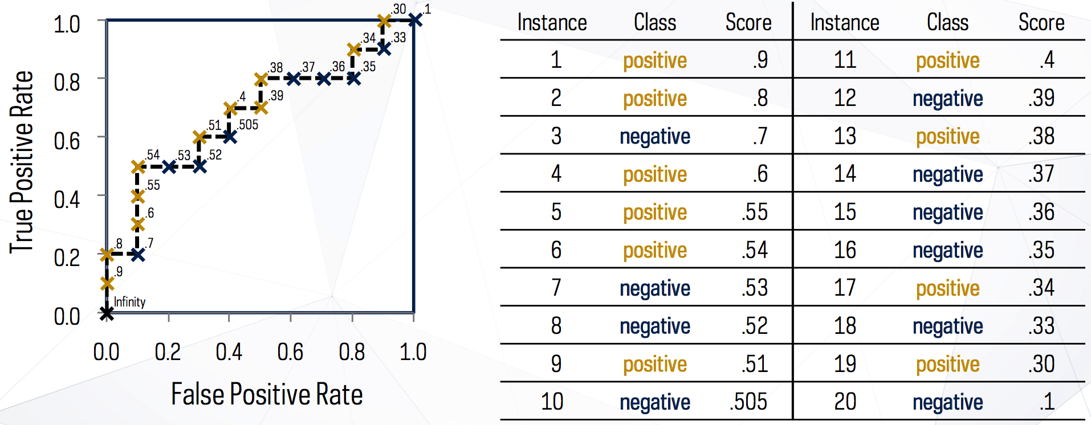
Generating ROC Curves: Final
TPR = TP/P = TP/(TP+FN)
FPR = FP/N = FP/(FP+TN)

Slide 43
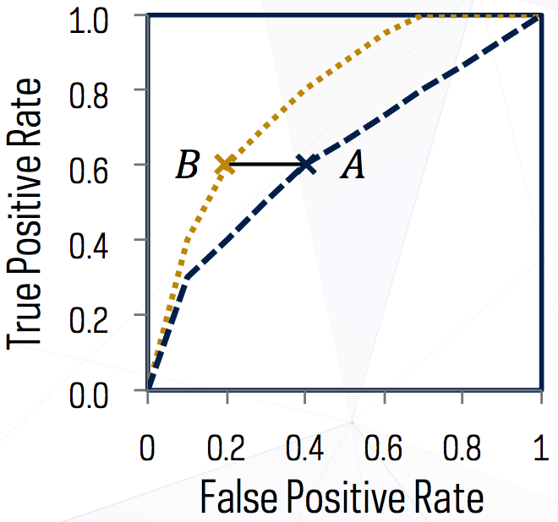
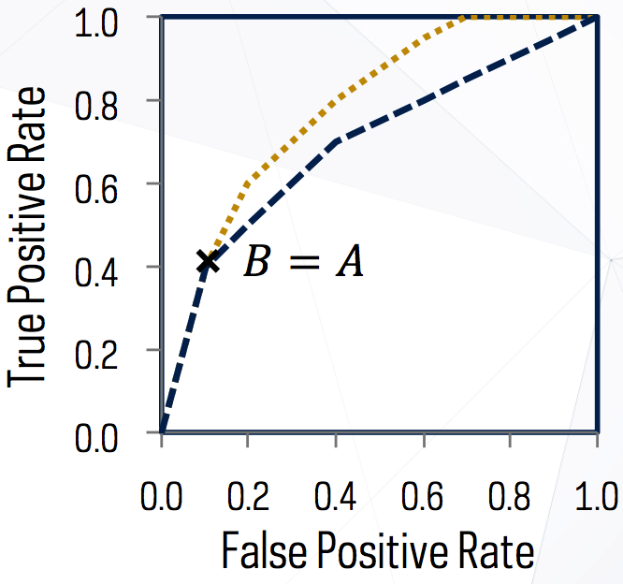
Comparing Classifiers in ROC Space
TPR = TP/P = TP/(TP+FN)
FPR = FP/N = FP/(FP+TN)

Slide 44
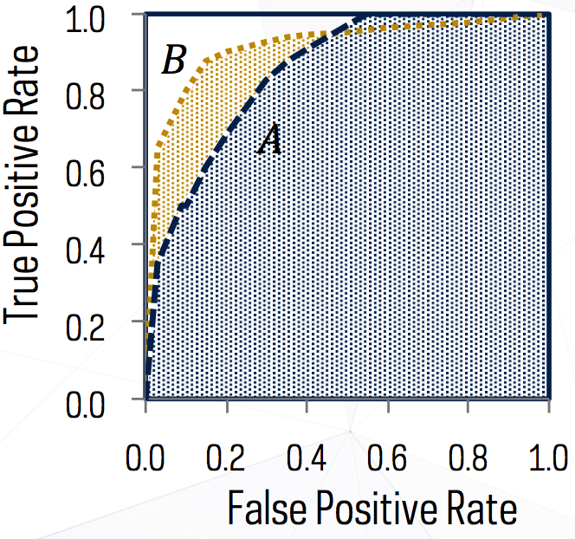
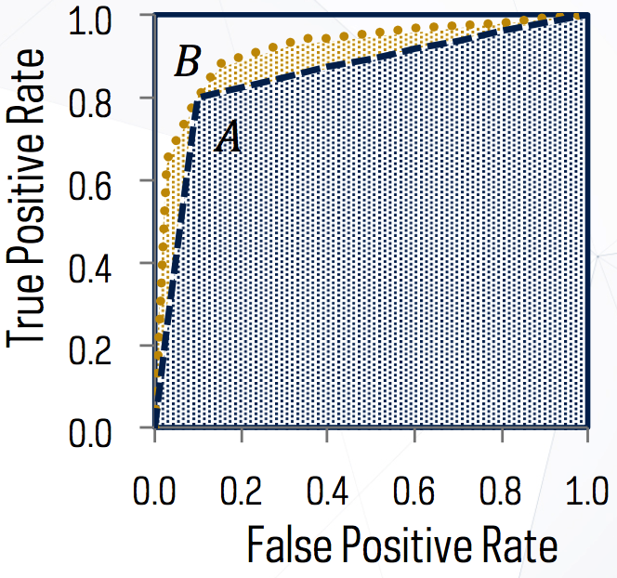
Metrics: (5) AUC
The area under the ROC curve (AUC) is a measure of the accuracy of the model
Summarizes model performance across all possible thresholds
A model with perfect accuracy will have an area of 1.0

Slide 45
Metrics: (5’) Precision-Recall Curve
How to plot?
Vertical axis represents Precision
Horizontal axis represents Recall
1
ideal
real
Precision = TP/P’ = TP/(TP+FP)
Recall = TP/P = TP/(TP+FN)
Precision
0
0
1
Recall

Slide 46
Today’s Lecture: Evaluation
Validation Settings
Hold-out validation method
Cross-validation methods (+ Stratified)
k-fold cross-validation
Leave-one-out validation
Evaluation Metrics
Confusion matrix
Accuracy, Error rate
Sensitivity, Specificity
Precision, Recall, F measure, G measure
ROC curves, Area Under the Curve (AUC), Precision-Recall Curve
Precision@K, Average precision
Mean absolute error (MAE), Root mean squared error (RMSE)
Ranking-based measures (Kendall’s tau, Spearman’s rho)

Slide 47
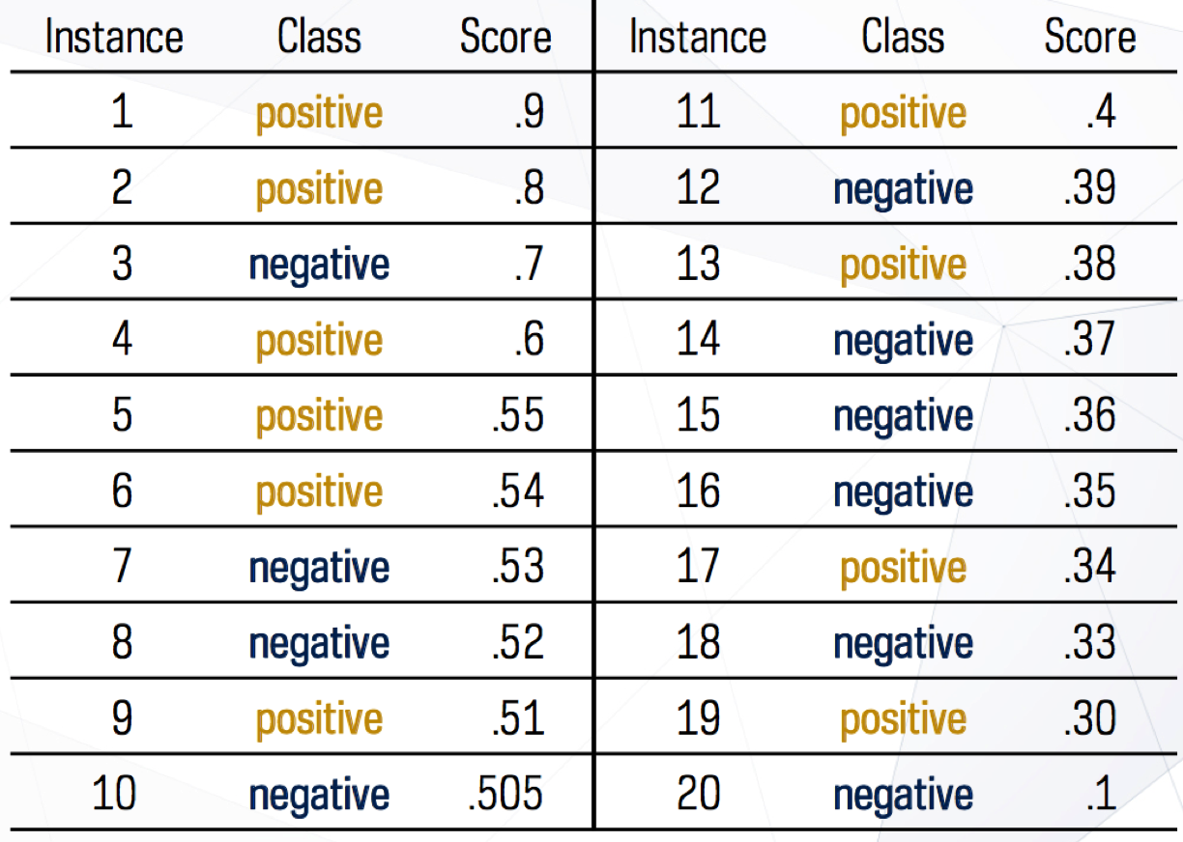
Metrics: (6) Precision@K
Precision@K
P@1 = 1.0
P@3 = 0.67
P@5 = 0.8
P@10 = 0.6

Slide 48
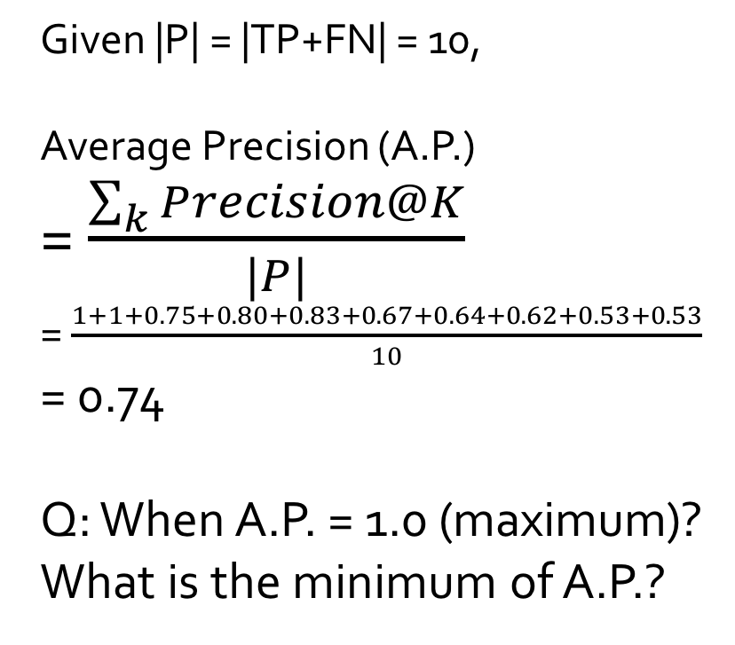
Metrics: (6) Average Precision
Average Precision
K | P@K | K | P@K
1 | 1.00 | 11 | 0.64
2 | 1.00 | 12 | 0.58
3 | 0.67 | 13 | 0.62
4 | 0.75 | 14 | 0.57
5 | 0.80 | 15 | 0.53
6 | 0.83 | 16 | 0.50
7 | 0.71 | 17 | 0.53
8 | 0.63 | 18 | 0.50
9 | 0.67 | 19 | 0.53
10 | 0.60 | 20 | 0.50
Given |P| = |TP+FN| = 10,
Average Precision (A.P.)
= $\frac{\sum_{k}{Precision@K}}{|P|}$
= $\frac{1+1+0.75+0.80+0.83+0.67+0.64+0.62+0.53+0.53}{10}$
= 0.74
Q: When A.P. = 1.0 (maximum)?
What is the minimum of A.P.?

Slide 49
Today’s Lecture: Evaluation
Validation Settings
Hold-out validation method
Cross-validation methods (+ Stratified)
k-fold cross-validation
Leave-one-out validation
Evaluation Metrics
Confusion matrix
Accuracy, Error rate
Sensitivity, Specificity
Precision, Recall, F measure, G measure
ROC curves, Area Under the Curve (AUC), Precision-Recall Curve
Precision@K, Average precision
Mean absolute error (MAE), Root mean squared error (RMSE)
Ranking-based measures (Kendall’s tau, Spearman’s rho)

Slide 50
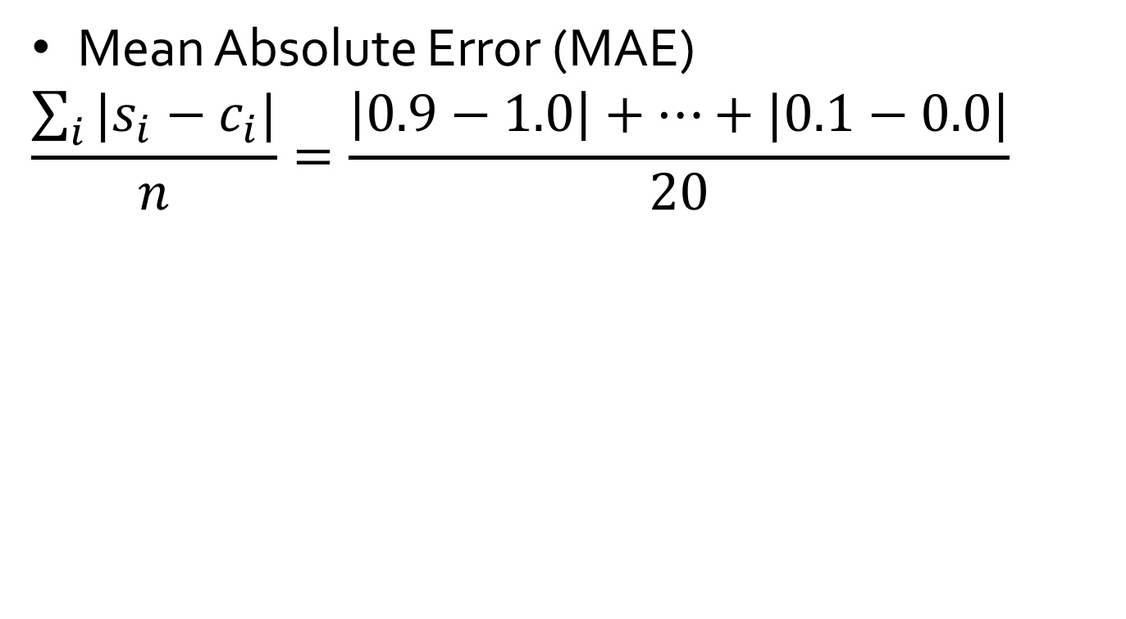
Metrics: (7) Errors
Mean Absolute Error (MAE)
$$\frac{\sum_{i}{|s_{i}−c_{i}|}}{n}=\frac{\left|0.9−1.0\right|+…+|0.1−0.0|}{20}$$

Slide 51
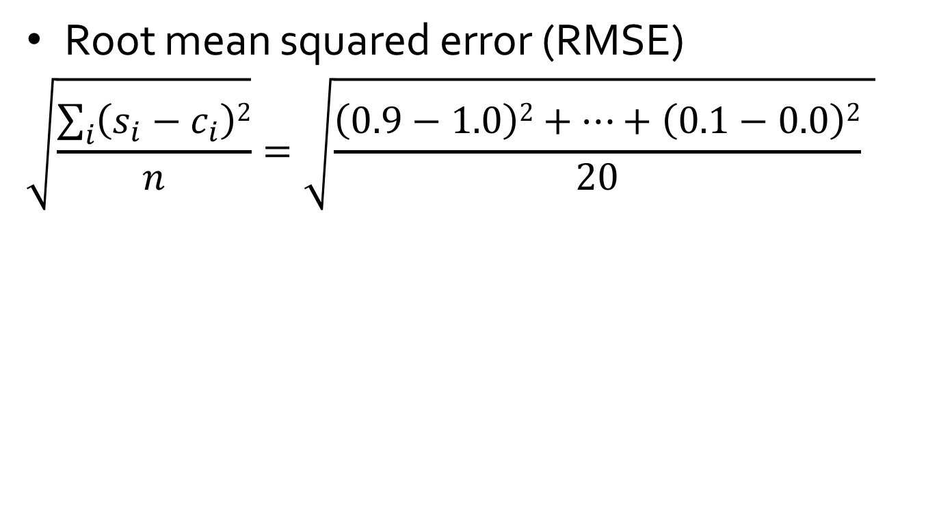
Metrics: (7) Errors
Root mean squared error (RMSE)
$$\sqrt{\frac{\sum_{i}{\left(s_{i}−c_{i}\right)2}}{n}}=\sqrt{\frac{\left(0.9−1.0\right)2+…+\left(0.1−0.0\right)2}{20} }$$

Slide 52
Today’s Lecture: Evaluation
Validation Settings
Hold-out validation method
Cross-validation methods (+ Stratified)
k-fold cross-validation
Leave-one-out validation
Evaluation Metrics
Confusion matrix
Accuracy, Error rate
Sensitivity, Specificity
Precision, Recall, F measure, G measure
ROC curves, Area Under the Curve (AUC), Precision-Recall Curve
Precision@K, Average precision
Mean absolute error (MAE), Root mean squared error (RMSE)
Ranking-based measures (Kendall’s tau, Spearman’s rho)

Slide 53
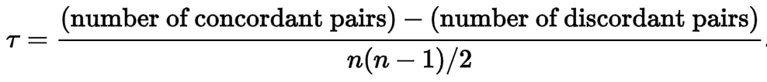
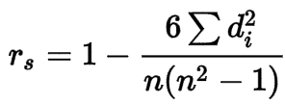
Metrics: (8) Ranking-based Measures
Rank correlation coefficients
Kendal’s tau
Spearman’s rho
where d_{i} is the difference
between two ranks

Slide 54
Check List: Evaluation Metrics
Confusion matrix
Accuracy, Error rate
Sensitivity, Specificity
Precision, Recall, F measure, G measure
ROC curve, Area Under the Curve (AUC), Precision-Recall Curve
Precision@K, Average precision
Mean absolute error (MAE), Root mean squared error (RMSE)
Ranking-based measures (Kendall’s tau and Spearman’s rho)

Slide 55
References
C. Apte and S. Weiss. Data mining with decision trees and decision rules. Future Generation Computer Systems, 13, 1997
P. K. Chan and S. J. Stolfo. Learning arbiter and combiner trees from partitioned data for scaling machine learning. KDD'95
A. J. Dobson. An Introduction to Generalized Linear Models. Chapman & Hall, 1990.
R. O. Duda, P. E. Hart, and D. G. Stork. Pattern Classification, 2ed. John Wiley, 2001
U. M. Fayyad. Branching on attribute values in decision tree generation. AAAI’94.
Y. Freund and R. E. Schapire. A decision-theoretic generalization of on-line learning and an application to boosting. J. Computer and System Sciences, 1997.
J. Gehrke, R. Ramakrishnan, and V. Ganti. Rainforest: A framework for fast decision tree construction of large datasets. VLDB’98.
J. Gehrke, V. Gant, R. Ramakrishnan, and W.-Y. Loh, BOAT -- Optimistic Decision Tree Construction. SIGMOD'99.
T. Hastie, R. Tibshirani, and J. Friedman. The Elements of Statistical Learning: Data Mining, Inference, and Prediction. Springer-Verlag, 2001.
T.-S. Lim, W.-Y. Loh, and Y.-S. Shih. A comparison of prediction accuracy, complexity, and training time of thirty-three old and new classification algorithms. Machine Learning, 2000

Slide 56
References (cont.)
J. Magidson. The Chaid approach to segmentation modeling: Chi-squared automatic interaction detection. In R. P. Bagozzi, editor, Advanced Methods of Marketing Research, Blackwell Business, 1994
M. Mehta, R. Agrawal, and J. Rissanen. SLIQ : A fast scalable classifier for data mining. EDBT'96
T. M. Mitchell. Machine Learning. McGraw Hill, 1997
S. K. Murthy, Automatic Construction of Decision Trees from Data: A Multi-Disciplinary Survey, Data Mining and Knowledge Discovery 2(4): 345-389, 1998
J. R. Quinlan. Induction of decision trees. Machine Learning, 1:81-106, 1986.
J. R. Quinlan. C4.5: Programs for Machine Learning. Morgan Kaufmann, 1993.
J. R. Quinlan. Bagging, boosting, and c4.5. AAAI‘96.
R. Rastogi and K. Shim. Public: A decision tree classifier that integrates building and pruning. VLDB’98
J. Shafer, R. Agrawal, and M. Mehta. SPRINT : A scalable parallel classifier for data mining. VLDB’96
J. W. Shavlik and T. G. Dietterich. Readings in Machine Learning. Morgan Kaufmann, 1990
P. Tan, M. Steinbach, and V. Kumar. Introduction to Data Mining. Addison Wesley, 2005
S. M. Weiss and C. A. Kulikowski. Computer Systems that Learn: Classification and Prediction Methods from Statistics, Neural Nets, Machine Learning, and Expert Systems. Morgan Kaufman, 1991
S. M. Weiss and N. Indurkhya. Predictive Data Mining. Morgan Kaufmann, 1997
I. H. Witten and E. Frank. Data Mining: Practical Machine Learning Tools and Techniques, 2ed. Morgan Kaufmann, 2005

